Slide 1
Communication and Network Security
Sonika Verma
CSCD92: Week 07

Slide 2
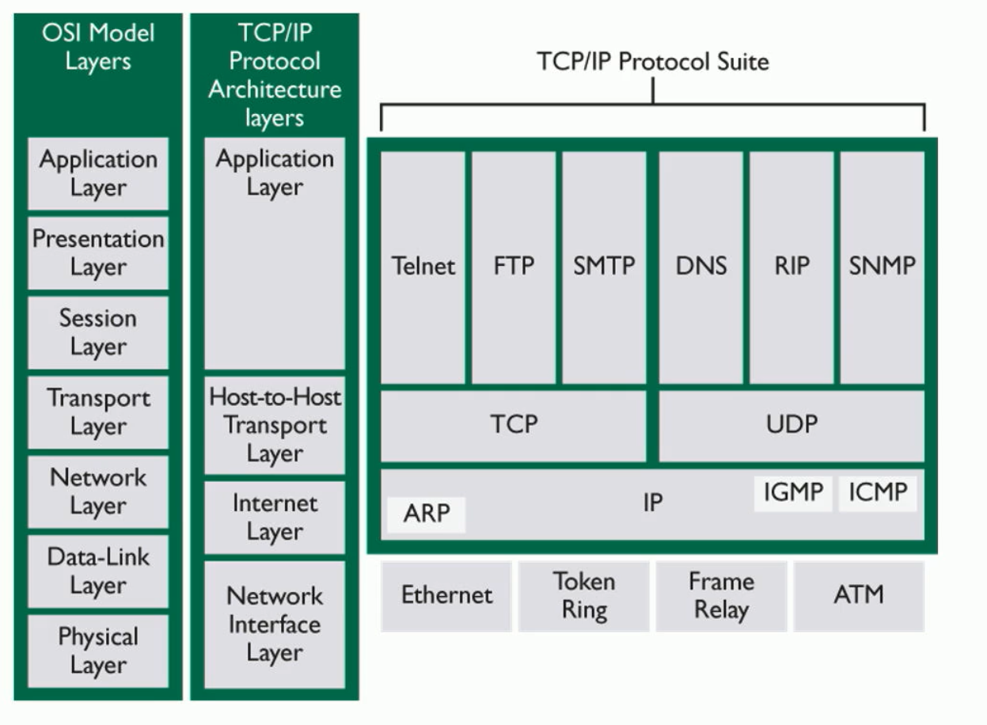
OSI & TCP/IP Models
Open System Interconnection
Transmission Control Protocol over Internet Protocol

Slide 3
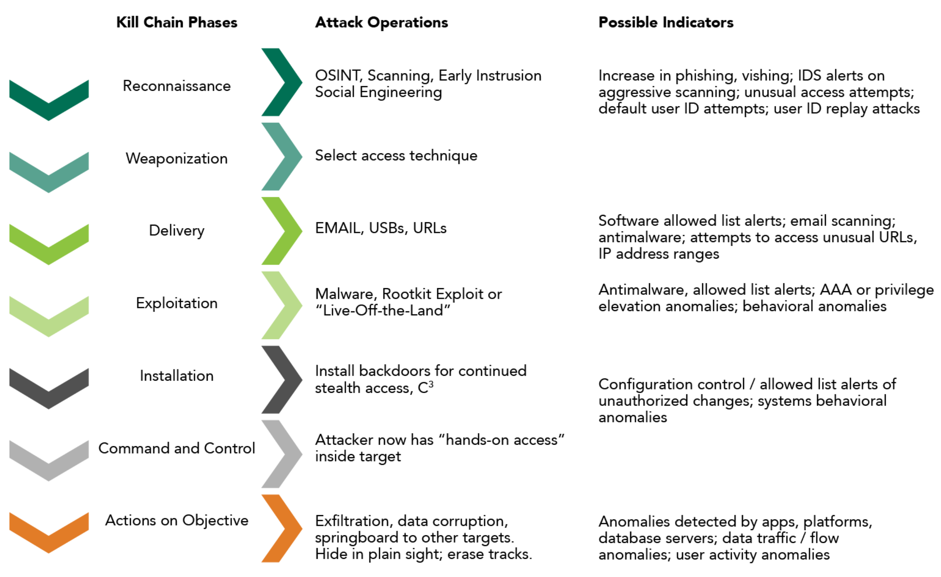
Threat Modeling
Threats
Hazards
Advances persistent threat models
Kill chain

Slide 4
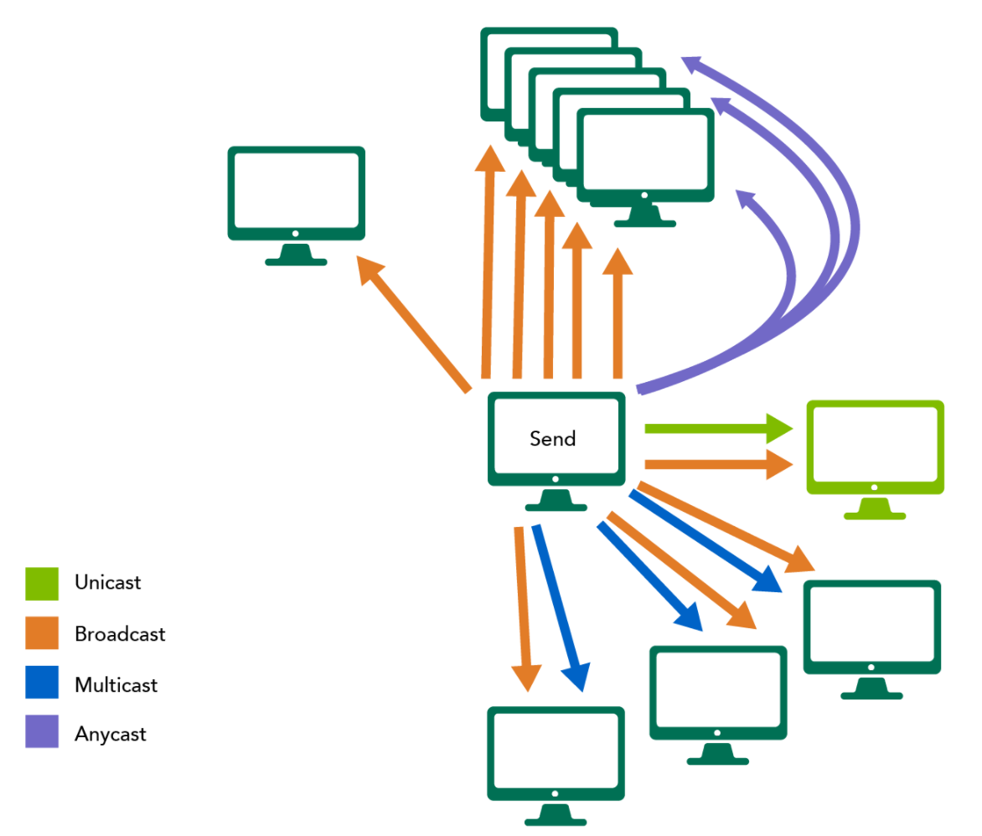
OSI Layer 01 : Physical
Encoded/decoded bits, signals
Network topology + traffic management
Bus, tree, ring, mesh, star
Bound vs unbound network
Common devices, wired/wireless media
Digital subscriber line
Asymmetric, rate adaptive, symmetric, very high bit rate
Wi-fi, broadband over powerline

Slide 5
OSI Layer 02 : Data Link
Encapsulated address information into frames
Media address control, logical link control
Protocols
Address resolution protocol (ARP)
Fibre channel over ethernet (FCoE)
Point-to-point (PPP), point-to-point over Ethernet (PPPoE)
Load management protocols.
Polling protocols
Connection based protocols
Carrier sense multiple access with collision [detection, avoidance] (CSMA/CD, CSMA/CA)
Switches, bridges
Virtual local area networks (VLANs)

Slide 6
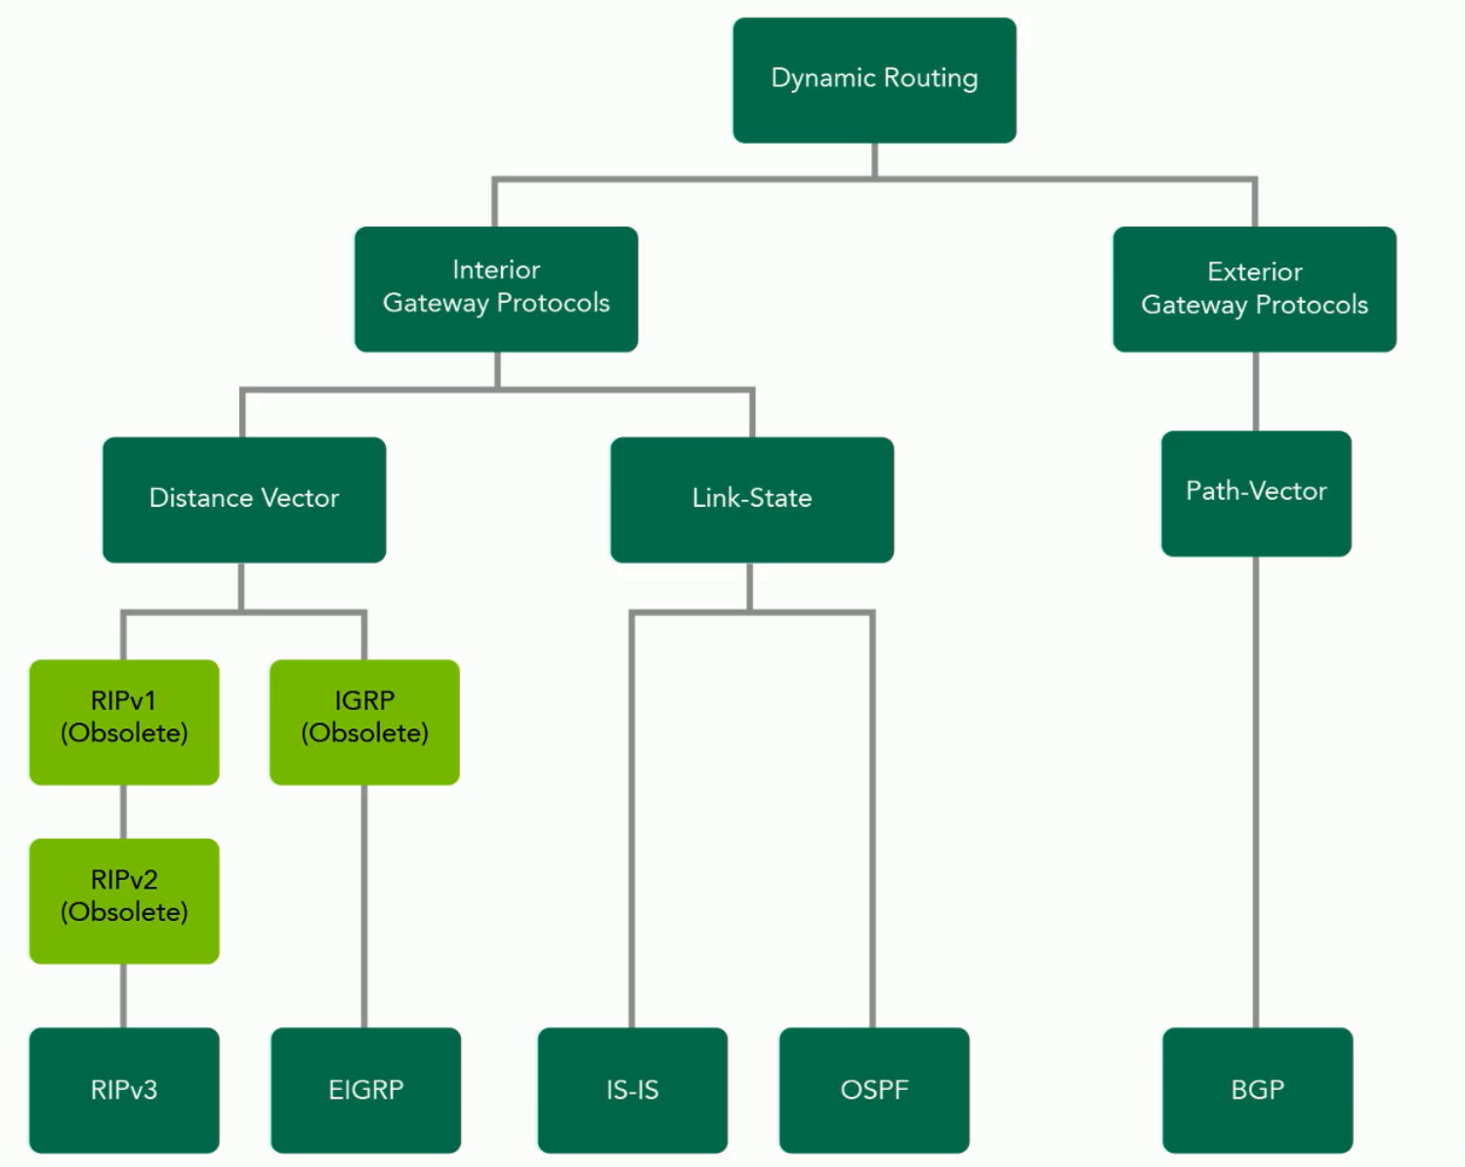
OSI Layer 03 : Network
Moving packets between hosts
Transmission forms
Unicast, broadcast, multicast, anycast, geocast
Logical addressing + Internet Protocol
Native IPv6, dual stack, tunneling, IPv6 at the edge
Automatic private IP addressing
Routers
Access control lists
Routing protocols
Routing information protocol
Path vector protocol
Border gateway protocol (BGP)
Link state protocol
Multiprotocol label switching (MPLS)
Routed protocols
Internet control message protocol (ICMP)
Internet group management protocol

Slide 7
OSI Layer 04 : Transport
Delivers end-to-end services, data segments
Port numbers + sockets
Protocols grouped by purpose
Transport, names and directory services, network operational support and management, web page operation, email, administrative
Transmission Control Protocol (TCP)
User Datagram Protocol (UDP)
Firewalls

Slide 8
OSI Layer 05 : Session
Logical persistent connection
Session protocols
Point-to-point sessions (PPP)
Password authentication protocol (PAP)
Challenge-handshake authentication protocol (CHAP)
Extensive authentication protocol (EAP)
Protected extensible authentication protocol (PEAP)
Tunneling
Remote procedure calls

Slide 9
OSI Layer 06 : Presentation
Formatted communication between systems
Gateway
Translation services

Slide 10
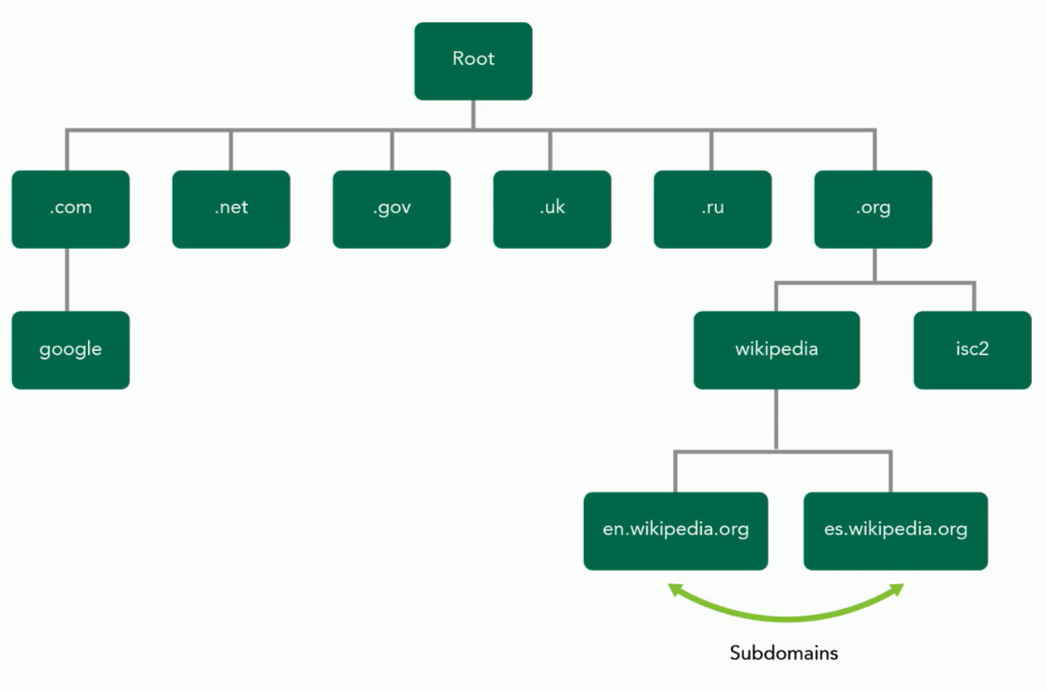
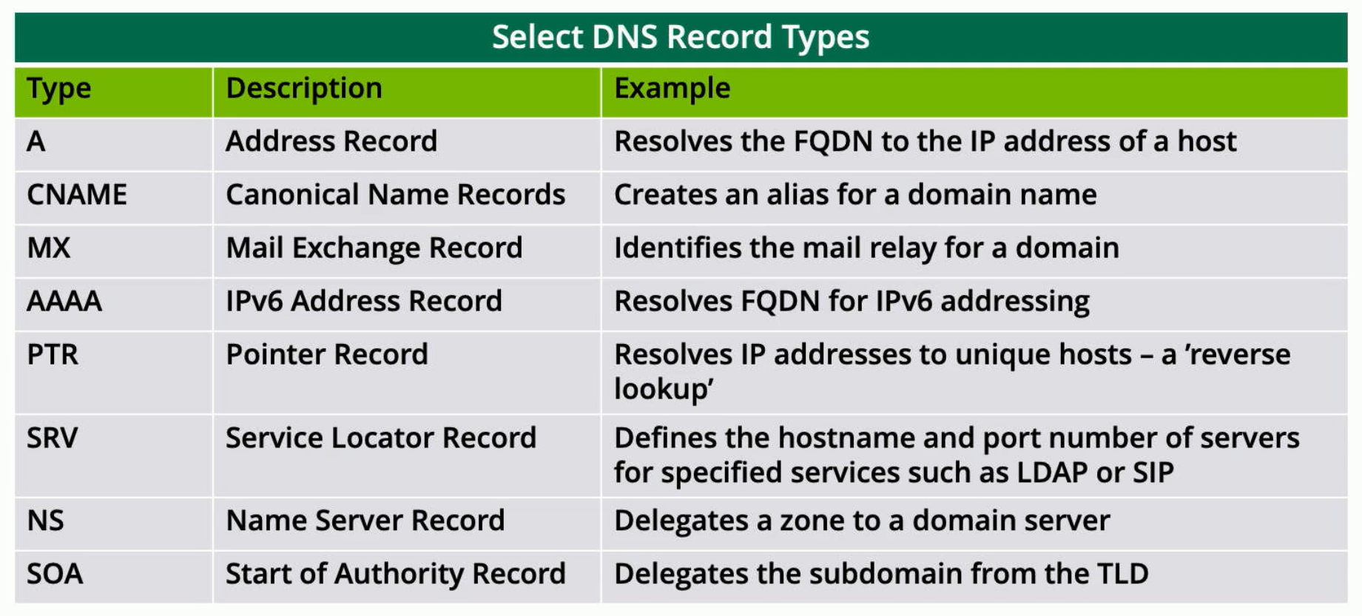
OSI Layer 07 : Application
Function of applications running on a system
APIs
Hypertext Transfer protocol
Dynamic host configuration protocol (DHCP)
Domain name system
Simple network management protocol (SNMP)
Lightweight directory access protocol (LDAP)

Slide 11
Secure Design Principles in Network Architecture
Legacy protocols
Internet relay chat (IRC)
Terminal emulation protocol (TELNET)
Remote login, remote shell, remote copy
Secure protocols
IP Security [authentication header, encapsulation security payload, security associations]
Transport mode, tunnel mode
Internet Key Exchange
Converged protocols
Software designed network (SDN)
Network virtualization
Network data flow and traffic management
Software-defined wide area network (SD-WAN)
Content distribution center (CDN)

